Slide 1


Example
TASK SCHEDULER
Find the best route to reach the destination city from the given starting point using a greedy method.
GREEDY APPROACH
Let’s have an overview about what Greedy algorithm is.
A greedy algorithm is an approach for solving a problem by selecting the best option available at the moment. It doesn't worry whether the current best result will bring the overall optimal result. The best thing about this algorithm is that it is easy to understand and implement.
It works in a top-down approach. The algorithm never reverses the earlier decision even if the choice is wrong.
This algorithm may not produce the best result for all the problems. It's because it always goes for the local best choice to produce the global best result.

Slide 2
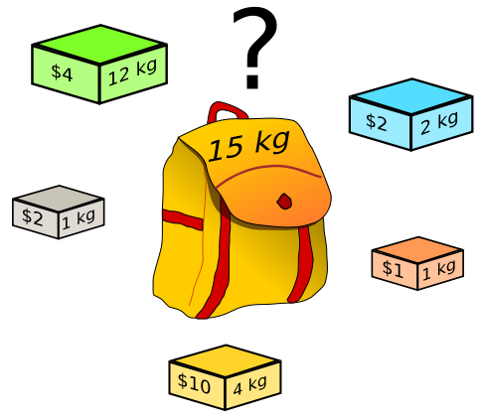
TASK SCHEDULER
GREEDY APPROACH
We can determine if this algorithm can be used with any problem if the problem has the following properties :
1.
2.
Greedy Choice Property:
Optimal Substructure:
Choosing the best option at each phase can lead to a global (overall) optimal solution.
If an optimal solution to the complete problem contains the optimal solutions to the subproblems, the problem has an optimal substructure.
Here is another example. The objective is to fill the bag of some given volume with different materials such that the value of selected items is maximized.

Slide 3

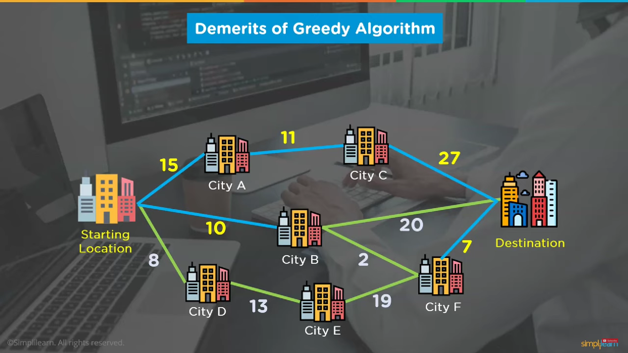
TASK SCHEDULER
Example
GREEDY APPROACH
Find the best route to reach the destination city from the given starting point using a greedy method.
As previously said, greedy approach will not always provides with the optimal solution. Here’s an example when greedy approach fails to give the optimal solution.
Click here to add the text
Your text has been concise and beautiful, but the information is
This time, the calculated route is not the optimised one. It is because greedy algorithm always goes for the local best choice to produce the global best result without looking for the broader part of the problem.

Slide 4

TASK SCHEDULER
GREEDY APPROACH
Now, let’s talk about the topic. We’ll see about task scheduler in the following context:
The Problem Statement
For an organizer, the main objective is to conduct as many events possible within the limited resources (say an auditorium) so as to make maxiumum profit out of it.
Why Greedy Approach?
Since we want to maximize the count of activities that can be executed.This approach will greedily choose an activity with earliest finish time at every step, thus yielding an optimal solution.
Working
From a given list of events we’ll have to find the maximum number of events possible.

Slide 5
Important Points
TASK SCHEDULER
It might not be possible to conduct all the events, since their timings can collapse.
Two events, say i and j, are said to be non-conflicting or compatible if startTime_{i} >= finishTime_{j} or startTime_{j} >= finishTime_{i.}
The scheduler will return the maximum - event set from the given list.
It is assumed that not more than one event is going to be conducted concurrently.
Problem Statement
Consider that you have n events with their start and finish time, the objective is to find solution set having maximum number of non-conflicting events that can be conducted in a single time frame, assuming that only one auditorum or hall is available for conducting.

Slide 6


Why Greedy Approach?
Greedy approach can be used to find the solution since we want to maximize the number of events that can be conducted.
This approach will greedily choose an event with earliest finish time at every step, thus yielding an optimal solution.
...the decision is taken on the basis of current available information without worrying about the effect of the current decision in future.
As per our requirement, we only have to include those events which have less duration and have compatibility between them.

Slide 7
TASK SCHEDULER
Explanation with sample input and output:
Working...
Start Time (s) | Finish Time (f) | EventName
5 | 9 | a1
1 | 2 | a2
3 | 4 | a3
0 | 6 | a4
5 | 7 | a5
8 | 9 | a6
Following are the steps we will be following to proceed with task scheduler:
Step 1: Sort the given events in ascending order according to their finishing time.
Step 2: Select the first event from sorted array and add it to Solution array.
Step 3: Repeat steps 4 and 5 for the remaining events.
Step 4: If the start time of the currently selected event is greater than or equal to the finish time of previously selected event, then add it to the Solution array.
Sorting the given input:
Start Time (s) | Finish Time (f) | EventName
1 | 2 | a2
3 | 4 | a3
0 | 6 | a4
5 | 7 | a5
5 | 9 | a1
8 | 9 | a6

Slide 8
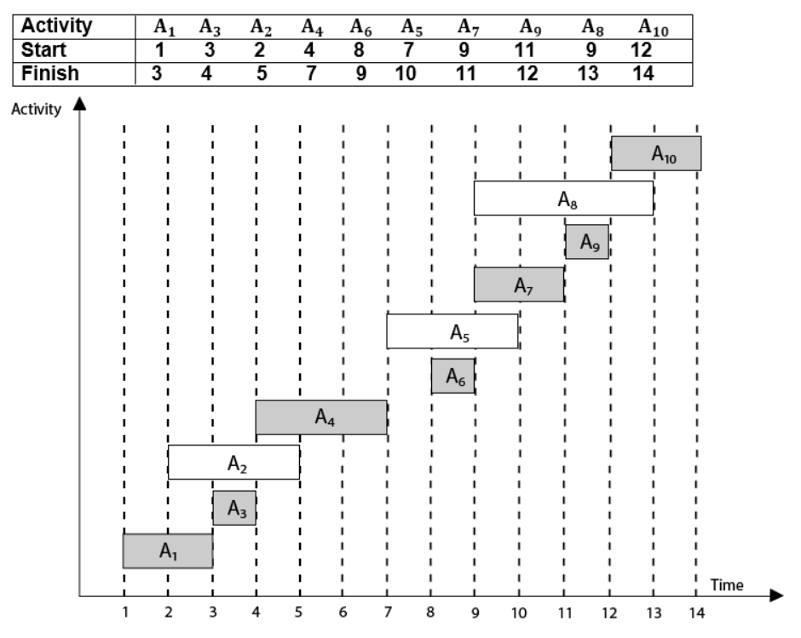

TASK SCHEDULER
Working...
Step 5: Select the next event in sorted array.
Step 6: Print the Solution array.
Now, schedule A1
Next schedule A3 as A1.
Next skip A2 as it is interfering.
Next, schedule A4 as A1 A3 and A4 are non-interfering, then next, schedule A6.
Next, schedule A7.
Next, schedule A9
Skip A8 as it is interfering.
Next, schedule A10 as A1 A3 A4 A6 A7 A9 and A10 are non-interfering.
Thus the final solution to the problem is:

Slide 9
ALGORITHM
TIME COMPLEXITY ANALYSIS
Case 1: When a given set of EVENTS are already SORTED according to their finishing time, then there is NO sorting mechanism involved, in such a case the complexity of the algorithm will be O(n).
Case 2: When a given set of EVENTS is UNSORTED, then we will have to use the sort() method. The time complexity of this method will be O(nlogn).
maxEvents (s, f, )
1. n ← length [s]
2. A ← {1}
3. j ← 1.
4. for i ← 2 to n
5. do if si ≥ fi
6. then A ← A ∪ {i}
7. j ← i
8. return A

Slide 10


Thank You

